Slide 1
Running GenAI on Intel AI Laptops and Simple LLM Inference on CPU and fine-tuning of LLM Models using Intel® OpenVINO™
Problem Statement

Slide 2
Idea
The AI Resume Matchmaker project is an innovative endeavor designed to revolutionize the recruitment process by leveraging artificial intelligence to match candidates' resumes with job descriptions with unparalleled precision and efficiency. This project aims to streamline the hiring process, reduce time-to-hire, and enhance the overall candidate experience.

Slide 3
Features Offered
Text Normalization
Percentage calculated on the basis of match found between Resume and Job Description
Uses GPT Turbo-3
HuggingFaces Transformers used

Slide 4
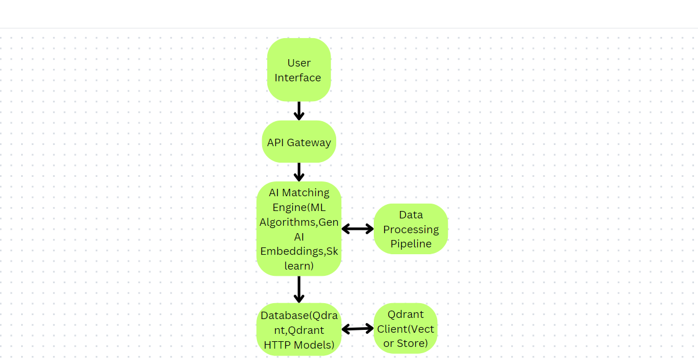
Process Flow

Slide 5
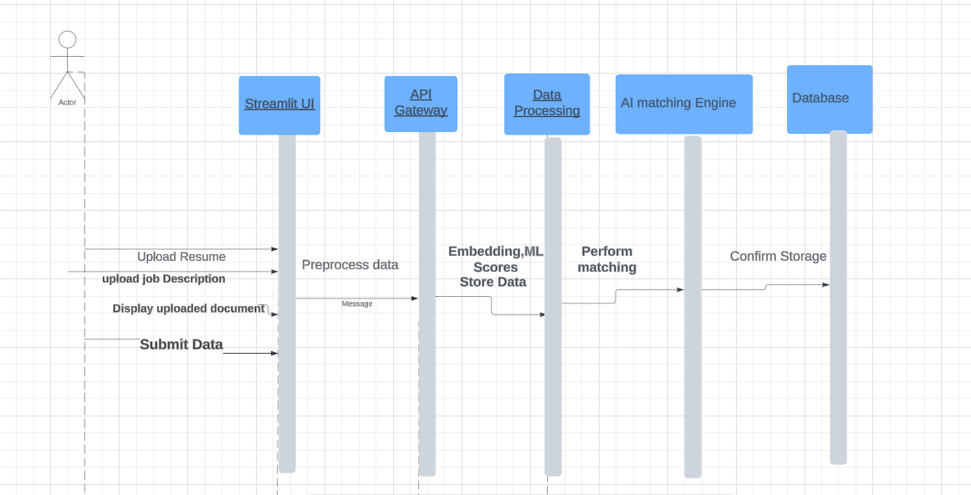
Architecture Diagram

Slide 6
Technologies Used
Web Application Framework
Streamlit
streamlit: Used for creating the web application interface
Data Manipulation
Pandas
pandas: Utilized for data manipulation and analysis.

Slide 7
Technologies Used
.
.
HuggingFace
langchain_community.embeddings.HuggingFaceBgeEmbeddings: Embedding models for text.
Google Generative AI
google.generativeai: Used for generative AI functionalities
PDF Processing
PyMuPDF
fitz: Reading and manipulating PDF documents.
FPDF
fpdf.FPDF: Creating PDF documents

Slide 8
Technologies Used
Vector Databases
Qdrant Client
qdrant_client: Client for interacting with the Qdrant vector database.
qdrant_client.http.models: Models for Qdrant HTTP API.
langchain_community.vectorstores.Qdrant: Vector store management.
OpenAI Integration
OpenAI
openai.OpenAI: API client for OpenAI services.

Slide 9
Conclusion
The AI Resume Matchmaker project successfully accomplished its primary goal of creating an advanced AI-driven platform to match candidates' resumes with job descriptions with high accuracy. This innovation significantly streamlines the recruitment process, improving efficiency and the overall candidate experience. Key outcomes include the development of an accurate resume matching system that leverages machine learning algorithms and generative AI embeddings, providing reliable matching scores. The user-friendly interface, built using Streamlit, allows for seamless upload and processing of resumes and job descriptions, while the integration of Qdrant as a vector database ensures efficient storage and retrieval of vector embeddings, enhancing the system's speed and performance. The use of powerful NLP libraries such as NLTK and Spacy enables effective text data preprocessing and analysis, ensuring high-quality input for the matching algorithms. Additionally, the use of Docker for containerization and environment management allows for consistent deployment across various environments, enhancing scalability.

